Slide 1

DriverPass System Analysis
Daniel Schween
Notes:
[No speaker notes required for this slide.]

Slide 2

System Requirements
Functional Requirements
The system shall permit the user to create a unique account, upload personal information, and customize their profile
The system shall allow the user to pick a package and schedule appointments.
Nonfunctional Requirements
The system will be adaptable, allowing admin to modify content/functionality and release system updates.
The system will have modern security using passwords, SSL encryption, 2-step verification, and cloud-based back up.
Notes:
Creating an account with DriverPass is essential because it allows the user to keep track of appointments, test scores, driver notes from the road test, and their progress toward completing online testing. Including the user’s personal information into their profile allows for seamless transactions and makes communication simple between the secretary, administration, and the driver. A custom profile and pre-loaded credit card information makes browsing and purchasing different driving packages much easier as well.
Business changes over time. Being able to modify profiles and the interface is key to maintaining our client base. Adding/Deleting different packages that are available will keep DriverPass up-to-date and competitive. Releasing updates based off user feedback will keep clients satisfied and engaged. Additionally, DriverPass must protect the user’s sensitive information. Including security measures whenever possible is necessary to protect our users from cyberattack, malware, and malicious third parties.

Slide 3
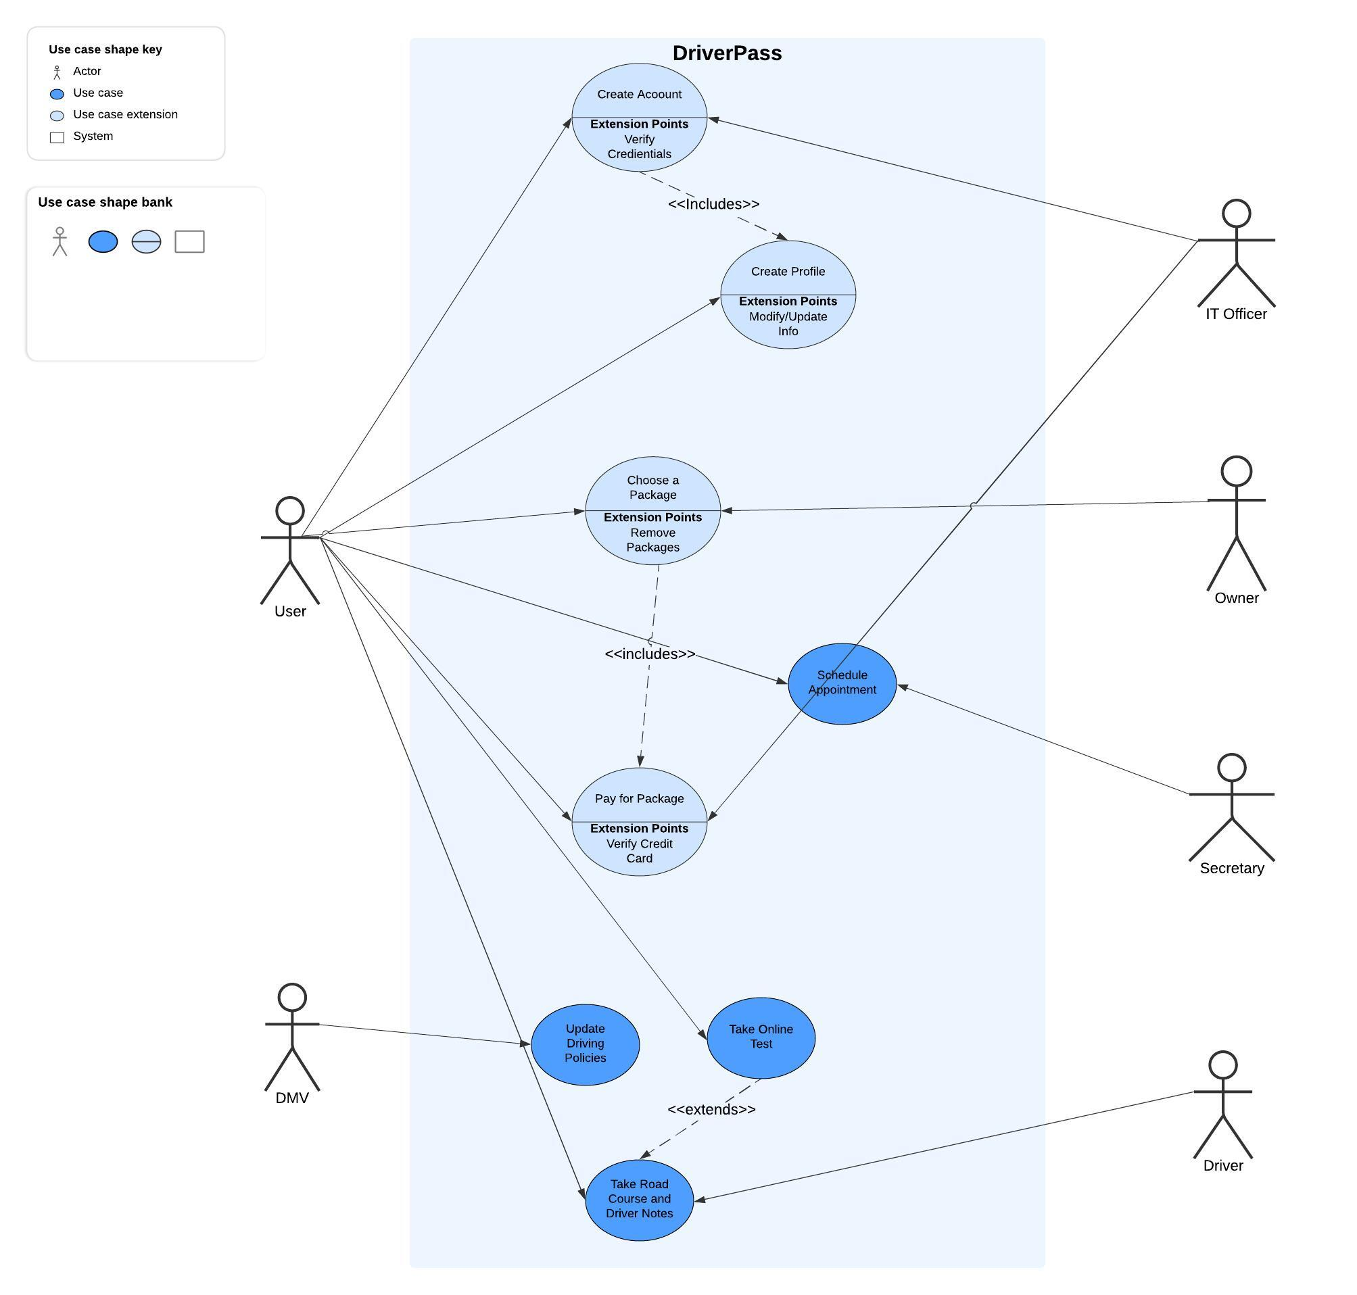
Use Case Diagram
[Insert your use case diagram here.]
Notes:
There are a few key players interacting with the webpage. Specifically, there is the user, the IT officer, the owner, the secretary, the driver, and the DMV. On the backend, a developer will update the interface and manage the technical requirements.
As we know, the user will be the main person interacting with the functions of the website in order to complete their certification. The IT officer will help manage the user’s experience and their account so they can verify information and make modifications, as necessary.
The owner will have access to all accounts and generate reports. The owner can then gather data and analyze how the business is doing so they can make improvements. If the client chooses to do so, they can contact the secretary and he/she will aid the client by scheduling appointments, assigning drivers, and sending reminders. The driver is responsible for taking the client out on the road, verifying pick-up/drop-off locations, and submitting feedback in the notes available on the website.
Finally, we must be in touch with the DMV to stay up-to-date with new policies and practice questions. The DMV will be connected to DriverPass and send notifications when there’s new information available.

Slide 4
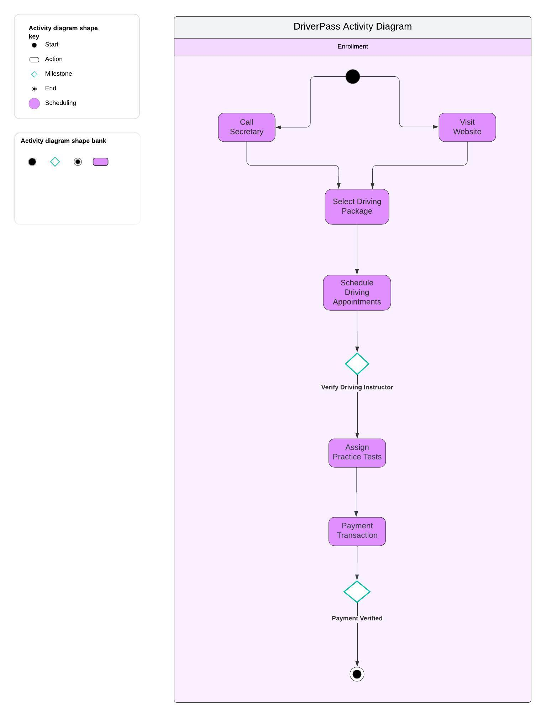
Activity Diagram
Notes:
An important part of the DriverPass business model is setting up and enrolling our clients. To start the enrollment process, the client will have to create an account on our website or call our secretary. After setting up an account and creating a profile, the client will be prompted to select a driving package. As we know, DriverPass offers three different packages based on how much practice the client is looking for.
Once a package is selected, we will schedule the client with appointment times and assign them a driver and dates to take the road test. By this point, the client will already have a profile with payment information, and we can make the final sale.

Slide 5
Security
The user is required to create a unique username and case-sensitive password.
The user’s data is encrypted using Secure Sockets Layer (SSL), securing the data and connection between the client and server.
“Brute Force” hack attempts will be deterred by disabling and locking out the account. The IT department will authorize account recovery.
Data will be backed up on the cloud in the event of a data breach or a system failure.
Notes:
Security is important to DriverPass because we want to protect our clients and their sensitive data. Good security shows positive integrity, and clients would be more willing to recommend our business to others. A unique username and password requirements are the first line of defense to protect the user's account. In the case a hacker is trying to login into a client’s account, we will lock out the account after a few attempts.
The user’s account holds sensitive data that we cannot jeopardize; protecting our user is a necessity. We do this by encrypting the data that is passed along between the website and the server. For emergencies, we will have all data backed up on the cloud, so the client does not have to worry about reuploading their profile.

Slide 6
System Limitations
The user may not have the hardware or software to support the cloud, the online tests, or updates.
The application does not have a built-in tutor. They may call the storefront or send a message online, but it could be cumbersome, and the response rate will not be immediate.
Due to time constraints, the mobile app may not be fully optimized. The website is priority, and the app will come second. The mobile app will have to be closely monitored and updated frequently.
Notes:
The biggest limitation the user may experience is educational support for when they are stuck on a topic or need further guidance. As of now, DriverPass is not a big enough organization to support on-demand tutoring. We can apply this feature in the future, but the administration will have to do their best to assist these needs.
On the technological side, some users may not have the proper hardware or software to support our features, such as online testing, downloads, updates, and cloud support. The administration will have to accommodate these unique users that do not have the tools for our modern design.
Furthermore, it is possible we may run out of budget or time to fully develop a mobile application. We will have a functional app, but it will take time and updates to optimize the experience. The app will have to be monitored and updated frequently.

